Slide 1
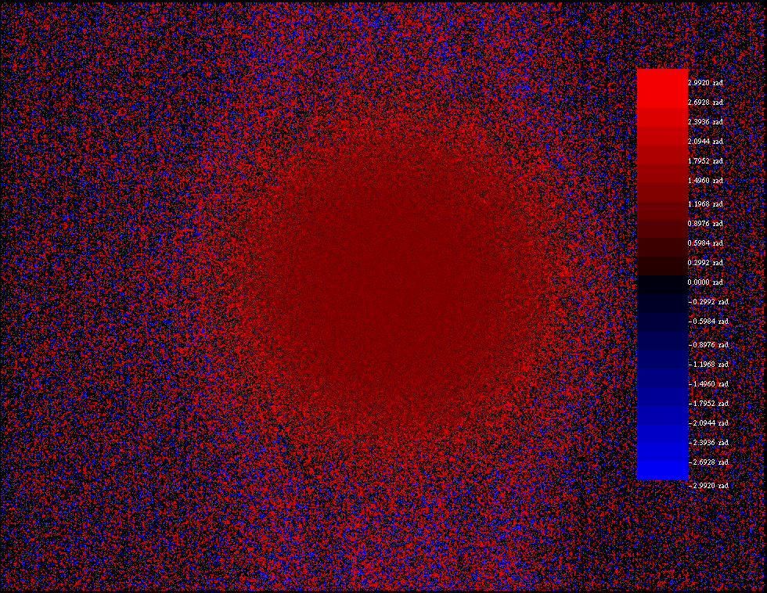
Real-time Phasemeter
June 6th 2024 Progress Report
Notes:
Carlos

Slide 2
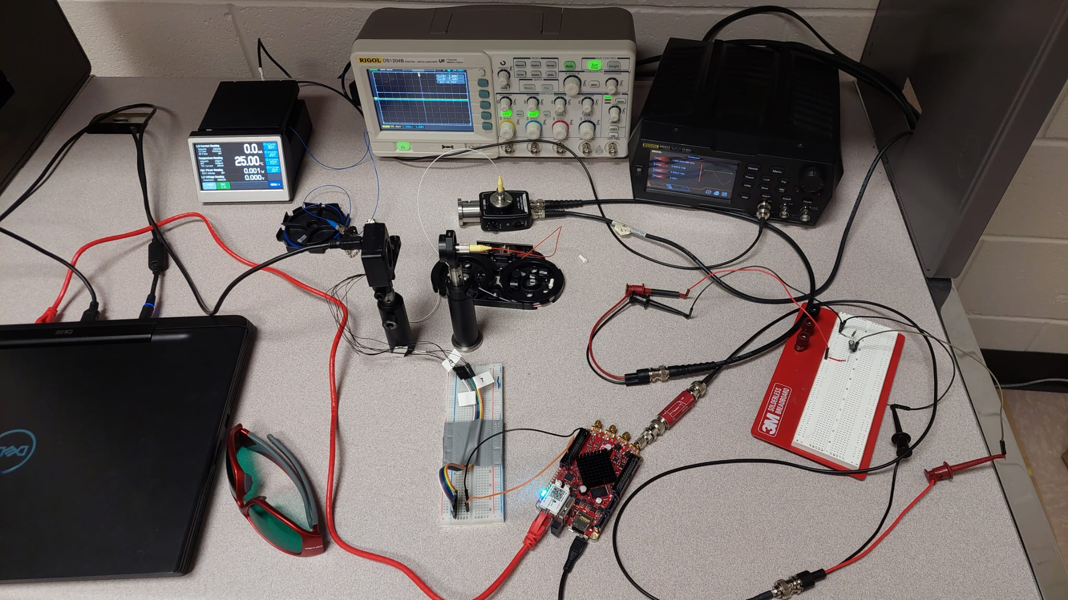
Laboratory Setup
Photodiode : currently broken
Oscilloscope
Laser diode
Waveform generator
camera
Analog High pass filter:
Will be made in PCB
Red pitaya
Notes:
Carlos

Slide 3
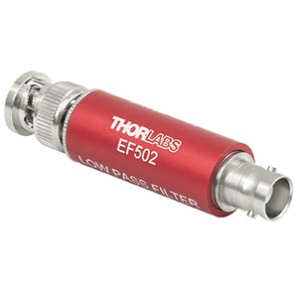
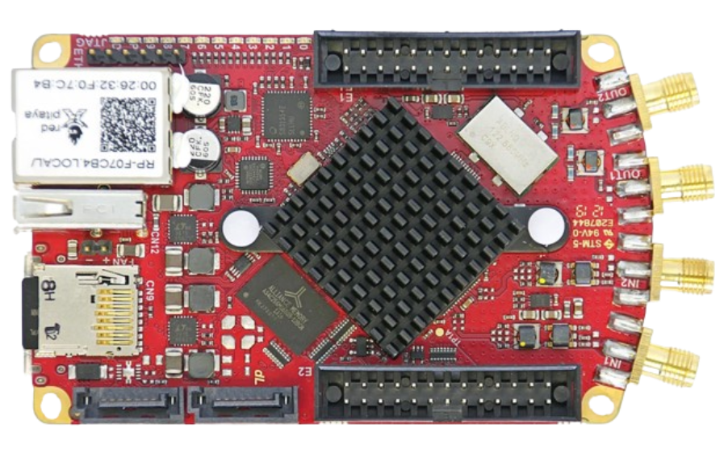
Layout
Waveform generator
*later to be replaced with interferometer
BNC Modulation
Photodiode
Fiber
Laser Diode
Fiber
Camera
BNC
USB
Analog Filter
Camera Trigger Signal
Display
100 Khz analog filter
PC
BNC
Red Pitaya
AND
Client/ server connection
Notes:
Carlos

Slide 4
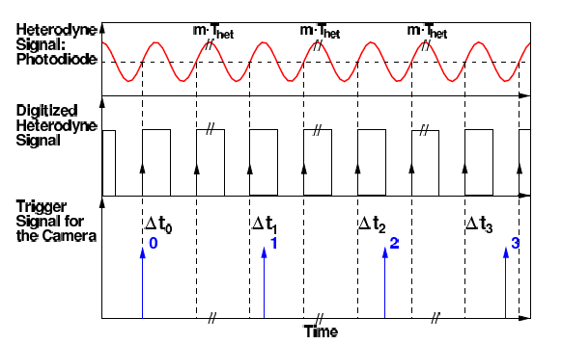
Delay in each trigger signal
Notes:
Carlos

Slide 5
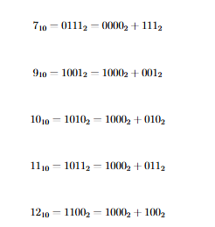
Client-Server Communication
The delay is set up through a binary messaging system. This works through specific bits indicating the readiness of the camera system, receiving trigger signals for delay slot. Messages are processed in the main program cycle to ensure accurate timing of the camera trigger delay
Five types of messages: 7 : camera is not ready
9 : camera is ready, use ¼ period delay
10: camera is ready, use ½ period delay
11: camera is ready, use ¾ period delay
12: camera is ready, use 1 period delay
Notes:
Change the use 1 to 0

Slide 6
Sending triggers and delays logic
Rising Edge Detector
Have we detected a rising edge?
AND
Quarter Period Delay
Trigger
Is the camera ready (ie. do we want a picture)?
GPIO
What delay to use? (¼ , ½, ¾ , 1)
Notes:
Carlos

Slide 7
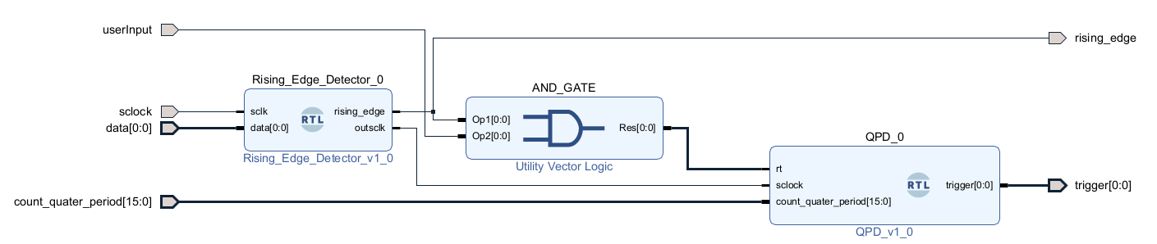
Vivado Block Diagram
Notes:
Carlos

Slide 8
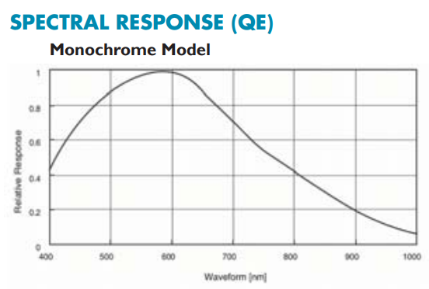
System Parameters
FPGA Settings:
Current sampling rate: 100 KHz
Max sampling rate: 125 MHz
LDC Settings: Frequency: 1 kHz
*This can be adjusted, there is a frequency counter implemented in FPGA
Wavelength: 1064 nm
Camera Settings:
Resolution: 1280x960
Color: B/W
The camera’s capabilities are limited at 1064nm: <10% sensitivity @ 1064nm wavelength
Notes:
Romi

Slide 9
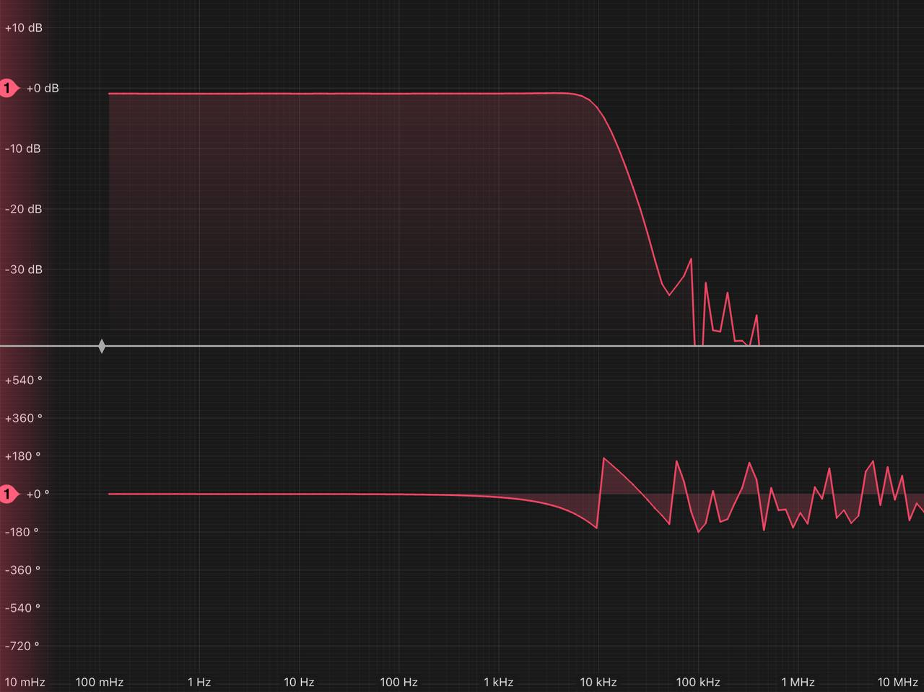
IIR Low pass Filter
Low pass filter bode plot
Coefficient | Floating point | Integer
b₀ | 0.062 | 507
b₁ | 0.124 | 1014
b₂ | 0.062 | 507
a₁ | 1.195 | 19,586
a₂ | -0.451 | -7,382
Low pass filter IIR formula:
y_{i1} = b₀x + b₁x_{i1} + b₂x_{i2} + a₁y_{1i1} + a₂y_{1i2}
In verilog: y1i<=($signed(507)*x+$signed(1014)*xi1+$signed(507)*xi2
+($signed(19586)*y1i1)+(-$signed(7382)*y1i2))>>>14;
18° phase delay @ 1kHz - how does this affect the phase calculations?
Notes:
Romi

Slide 10
Current Results
Example phasefront result - phases in red are positive and phases in negative are blue
Ideally, this should be a flat wavefront.
There is noticeable noise outside the center. For the following calculations (phase mean and standard deviation), we only include the center region ~ 100 px x 100px.
Notes:
Josh

Slide 11
Current Results
Maximum frame rate achieved so far: 2.2 frames per second
Current resolution: 1280 x 960
Decreasing the frame rate should yield higher FPS
What is more important, framerate or resolution?
Adjusting the way the camera sends information (Y8 vs. Y16) may give different results as well
Notes:
Josh

Slide 12
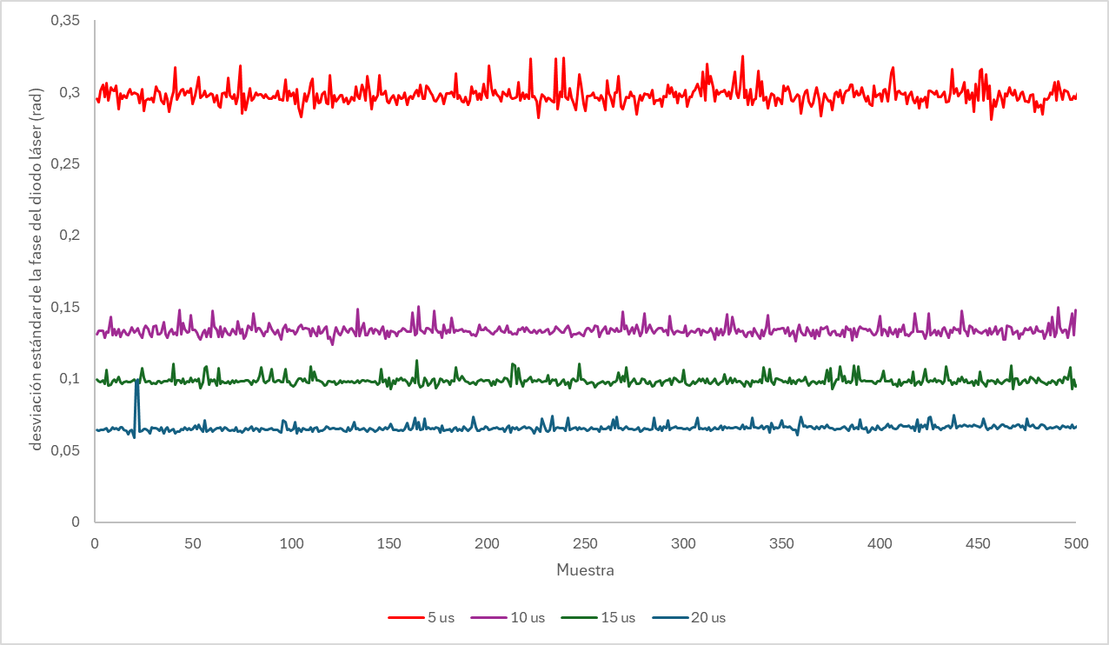
Current Results
Comparison between standard deviation results across 500 measurements for different exposure times.
5 μs*: ~0.3 rad
10 μs: ~0.125 rad
15 μs: ~100 mrad
20 μs: ~60 mrad
Not great results here yet. Adjusting aperture and shutter speed may give a lower standard deviation.
*5 μs is the end desired exposure time. Focus should be placed here to maximize results
Notes:
Josh

Slide 13
What’s next (not in order):
Fix/replace broken photodiode
Implement clocking
Use various lenses to test results
Find proper lens mount
Finish bandpass filter within FPGA (for lower frequencies)
Quantify how impactful the ~18 ° delay that the digital filter inputs to the signal
Adjust camera settings
Frame rate, resolution, image settings (y8 vs. y16), exposure
Connect to interferometer
Run a long term test
Maximum ran: ~ 8 mins
Goal: +1 hour
What’s our budget?
Look into acquiring the STEMlab 124-14 4 inputs. This model has a pin for an external clock signal.
Consider getting a new camera that’s better suited to the laser’s wavelength.
Notes:
Josh
Thorlabs laser diode in visible wavelength 1060 nm?
Make it in visible light

